Slide 1

Serial Peripheral Interface (SPI)
Self - investigation
Date:
Name: Phuc che
engineer, RA FSP,
FSP1
Renesas Electronics Corporation

Slide 2
Agenda
OVERVIEW Page 03
Spi on renesas advance chip (RA family) Page 18
FSP OF SPI Page 33
Q&A Page 37
APPENDIX Page 38

Slide 3
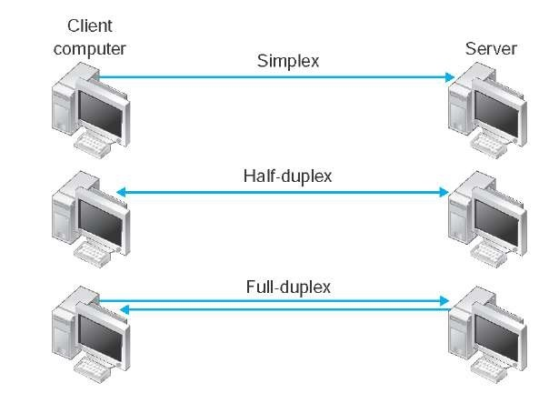
Overview what is SPI ?
SPI is the short term of Serial peripheral interface
SPI used for communication between MCU and peripheral ICs (Ex: sensors, ADCs, DACs, SRAM, …)
SPI is a full-duplex interface
=> Faster than I2C which only work in half-duplex

Slide 4
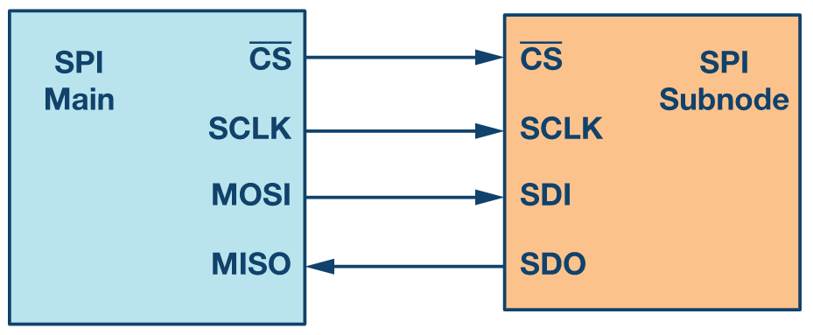
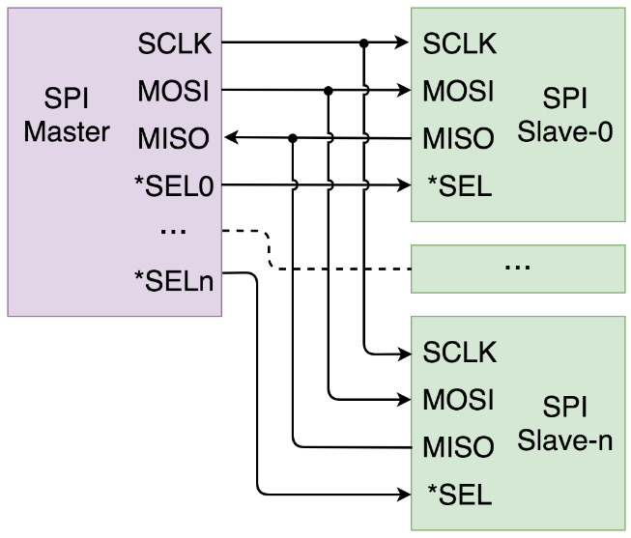
Overview basic concept
CS is active low, pull high to disable slave from master.
SCLK supported from master to slave to ensure the synchronization.
MOSI and MISO help Master and slave can communicate simultaneously.
HIGH / LOW
1 1 0 0 1 1 0 1
1 1 1 0 0 0 0 1
SCLK : Clock
CS : Chip select
MOSI : main out - subnode in
MISO : main in, subnode out
SDI : subnode data in
SDO : subnode data out
Master can control multi slave

Slide 5
Overview how he works – Initialize state
HIGH
At initialize state the CS will be HIGH, user need to change the CS state of Master to LOW for activating the Slave

Slide 6
Overview how he works – SETUP state (1/4)
LOW
After enabled the Slave, a clock must be provided to Slave in order for Master and Slave working synchronously
CPOL and CPHA need to be set for choosing the behavior of Master – Slave when clock state change
CPOL : Clock Polarity
CPHA : Clock Phase

Slide 7
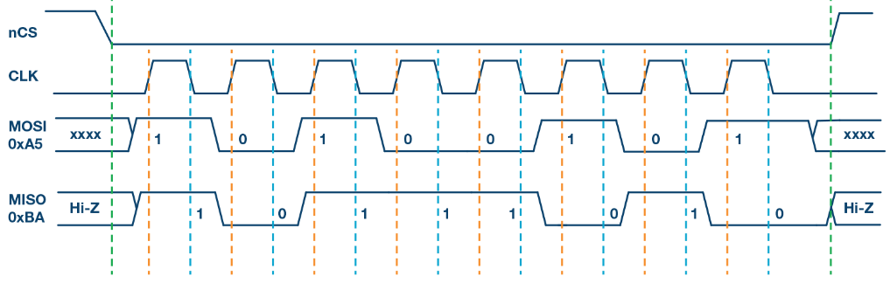
Overview how he works – SETUP state (2/4)
CPOL is the bit which set the polarity of the clock signal during idle state
What is idle state ?
Idle
CPOL = 0
LOW
LOW

Slide 8
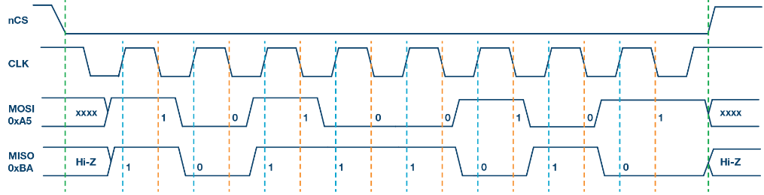
Overview how he works – SETUP state (3/4)
CPOL is the bit which set the polarity of the clock signal during idle state
What is idle state ?
CPOL = 1
HIGH
HIGH
LOW
LOW

Slide 9
Overview how he works – SETUP state (4/4)
CPHA is the bit which set the SPI sample/shift data on rising/falling edge of clock
Rising edge
Falling edge

Slide 10
Overview how he works – transmission state (1/2)
Master send 1010_0101 (0xA5) to Slave
Sample the bit “1” to MOSI when clock at rising edge
Shift bit in register
Working of SPI when CPOL = 0, CPHA = 0
- - - - - - : Start/End data transmission
- - - - - - : Sampling data
- - - - - - : Shift data
Note:
- Hi-Z (high impedance) ensure the current slave will not collide with another slave which may be selected also.

Slide 11
Overview how he works – data transmission concept (1/6)
Init state, there is no data be transferred
Note: CPOL = 0, CPHA = 0

Slide 12
Overview how he works – data transmission concept (2/6)
When SCLK change state from LOW to HIGH, target bit was sampled
Note: CPOL = 0, CPHA = 0

Slide 13
Overview how he works – data transmission concept (3/6)
CLK change HIGH to LOW, all bits will be shifted ahead
Note: CPOL = 0, CPHA = 0

Slide 14
Overview how he works – data transmission concept (4/6)
Note: CPOL = 0, CPHA = 0

Slide 15
Overview how he works – data transmission concept (5/6)
Note: CPOL = 0, CPHA = 0

Slide 16
Overview how he works – data transmission concept (6/6)
Continue the flow till all bits were transferred
Note 1: Above example is MSB-first transmission method, there also LSB-first transmission method in SPI
3 bit which have just received from Master
Note 2: You can refer Fig 30.14 and 30.15 in HWUM
3 bit which have just received from Slave
Note 3: CPOL = 0, CPHA = 0

Slide 17
Overview how he works – transmission state (2/2)
Depend on the CPOL and CPHA value, there are 4 mode of SPI available
SPI Mode | CPOL | CPHA | CLK Ide State | Sample Edge | Shift Edge
0 | 0 | 0 | LOW | Rising | Falling
1 | 0 | 1 | LOW | Falling | Rising
2 | 1 | 0 | HIGH | Rising | Falling
3 | 1 | 1 | HIGH | Falling | Rising

Slide 18
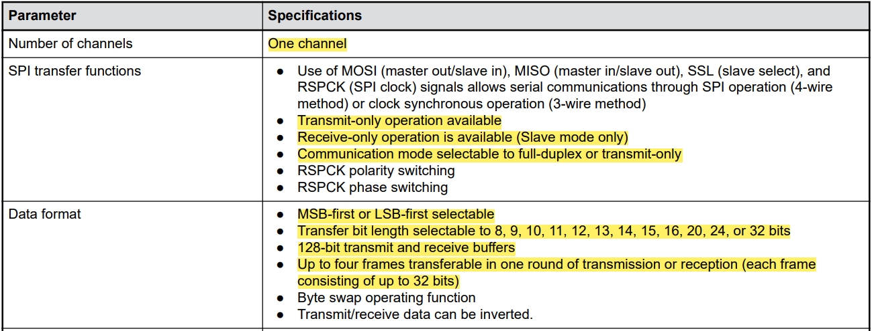
Spi on renesas advance chip (RA family) overview specification (1/3)
Note: This slide only show some highlight feature, for detail specification, please check RA4M3 HWUM - Sec 30

Slide 19
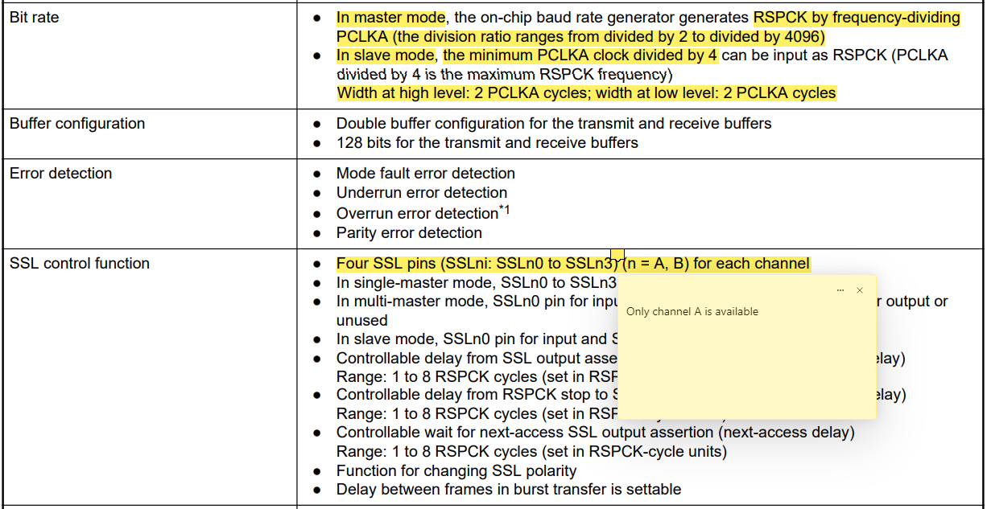
Spi on renesas advance chip (RA family) overview specification (2/3)
Note: This slide only show some highlight feature, for detail specification, please check RA4M3 HWUM - Sec 30

Slide 20
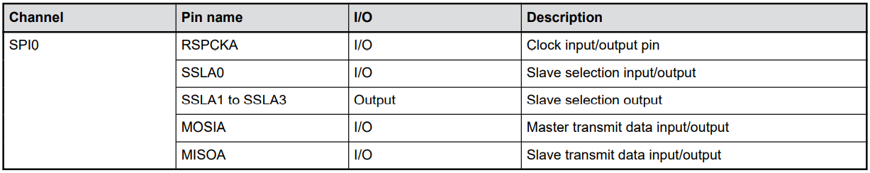
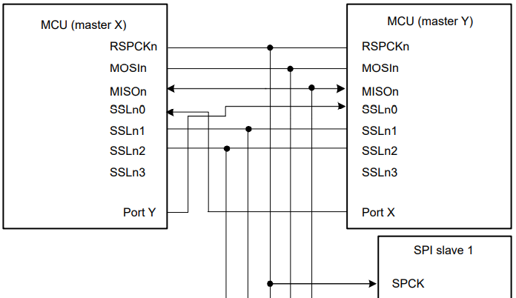
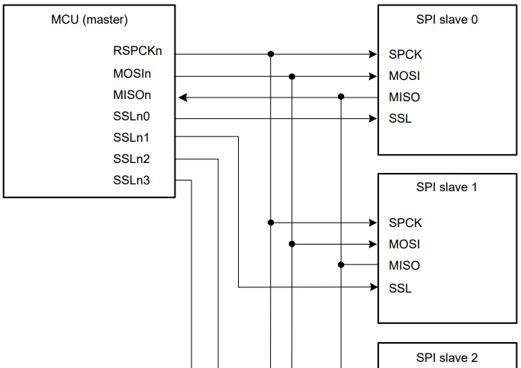
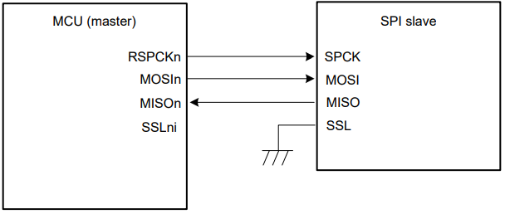
Spi on renesas advance chip (RA family) overview specification (3/3)
Pin name of RA family SPI module
Note:
- SSLA0 is used for communicating between masters in multi-master mode
- In Single – Multi Master Slave, SSLA0 is used as chip select for the Slave 0
- In Single – Single Master Slave, SSLA0 not used

Slide 21
Spi on renesas advance chip (RA family) operation modes – Overview
SPI module in RA family has following operation:
+ SPI operation (4-wire method)
Single – master mode
Multi – master mode
Slave mode (only 1 SPI slave)
+ Clock synchronous operation (3 wire method)

Slide 22
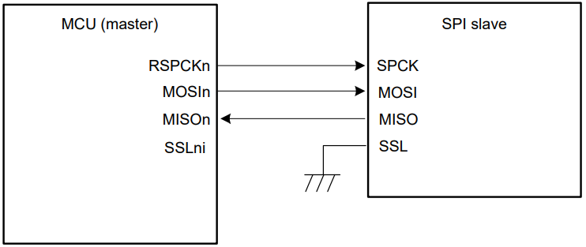
Spi on renesas advance chip (RA family) operation modes – SPI operation (1/4)
Slave mode
MCU and SPI can ex-change the role Master/Salve with each other
When MCU is Master, SSLni is not used
SSL of Slave is fixed to the LOW level
MCU is Master, SPI is slave

Slide 23
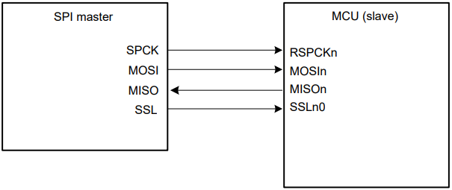
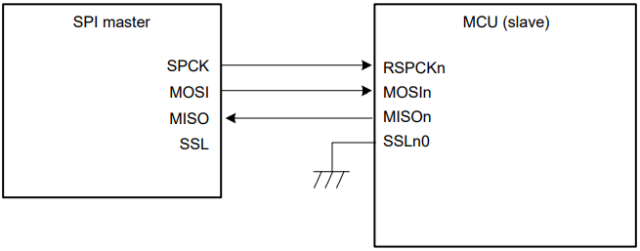
Spi on renesas advance chip (RA family) operation modes – SPI operation (2/4)
Slave mode
When MCU is Slave, SPI is Master and CPHA is 1. The input of SSLn0 is fixed to the low-level
SPI is Master, MCU is slave, CPHA = 0
SPI is Master, MCU is slave, CPHA = 1

Slide 24
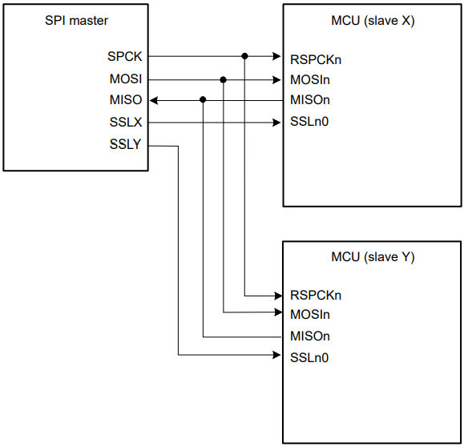
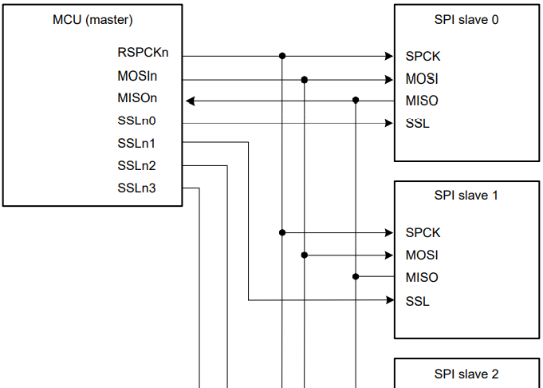
Spi on renesas advance chip (RA family) operation modes – SPI operation (3/4)
Single – Master mode
MCU is Master, SPIs are Slaves
SPI is Master, MCUs are Slaves
Note:
- There are 2 types to connect multi-Slaves to a Master, Direct Connect (being used above ) and Daisy-chained
- Daisy-chain is using only 1 SSL (CS) to select the Slave
- In Daisy-chain, data will be sent sequentially from Master -> Slave 1 -> Slave 2 -> . . .

Slide 25
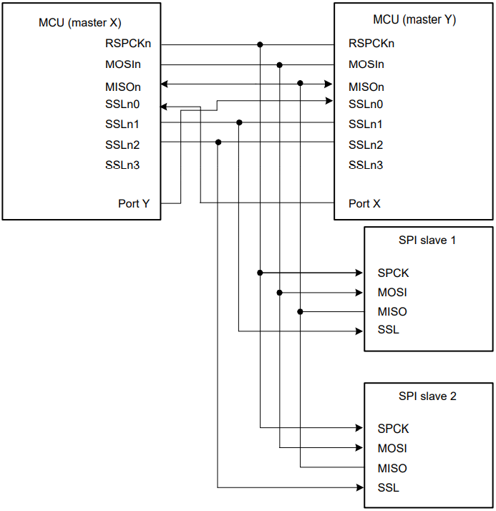
Spi on renesas advance chip (RA family) operation modes – SPI operation (4/4)
Multi – Master mode
SSLn0 used to control which MCU is using the Slave
When SSLn0 is LOW, the MCU current MCU detect mode fault, he will stop control the slave and release SPI bus for other MCU
On SPI Slave, only when SSL is LOW that mean the MCU is choosing that Slave to control
MCUs are Masters, SPIs are Slaves

Slide 26
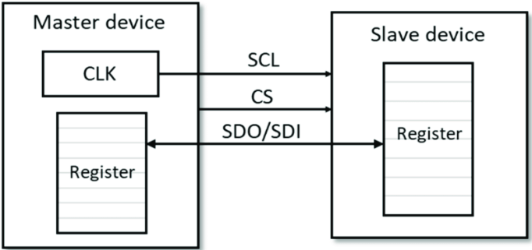
Spi on renesas advance chip (RA family) operation modes – clock synchronous operation
The Clock synchronous operation is the communication method which use 3-wire instead of 4-wire as SPI Operation
This operation is a half-duplex communication method
There is only 1 wire which handle for data transmission. At the result, there is one direction of data can be transmitted at a time

Slide 27
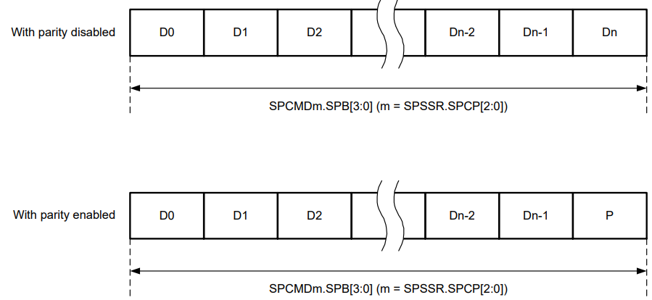
Spi on renesas advance chip (RA family) data formats
There are 2 data format types:
+ Parity bit enabled
+ Parity bit disabled
Parity bit
Note: Parity bit is used for error detection

Slide 28
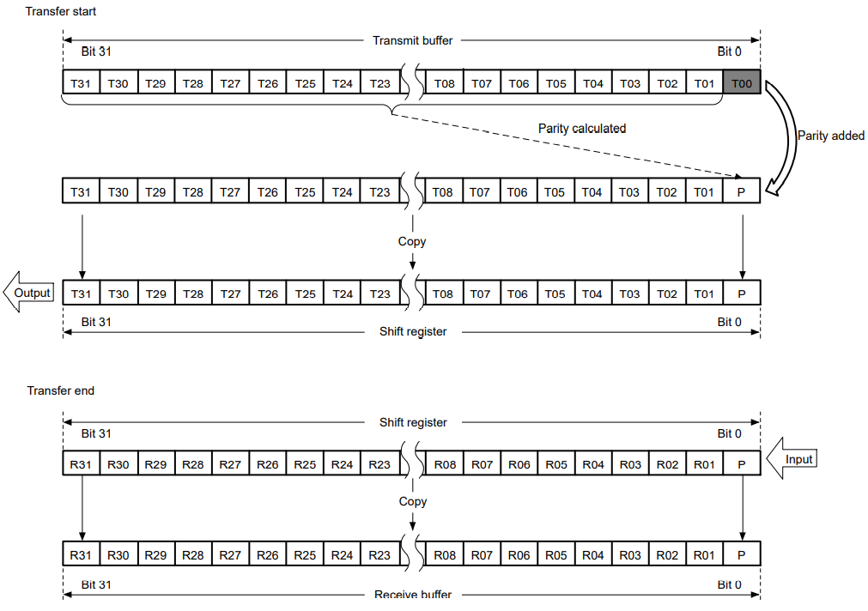
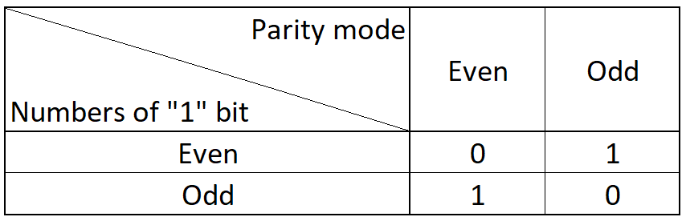
Spi on renesas advance chip (RA family) data formats – Parity bit
Parity is the numbers “1” bit is even/odd
Ex: 1100_111P
- P is parity bit
- If parity mode is even. Bit stream become:
1100_1111
- If parity mode is odd. Bit stream become:
1100_1110
Transmit the parity data format for MSB – first transmission

Slide 29
Spi on renesas advance chip (RA family) data formats – Data transmit with parity (1/2)
In mode MSB – first, the parity bit always place at the end of bit stream (at LSB)
Transmit the parity data format for MSB – first transmission
Note: For the parity disable, please refer to slide Overview how he works – data transmission concept (1/6)

Slide 30
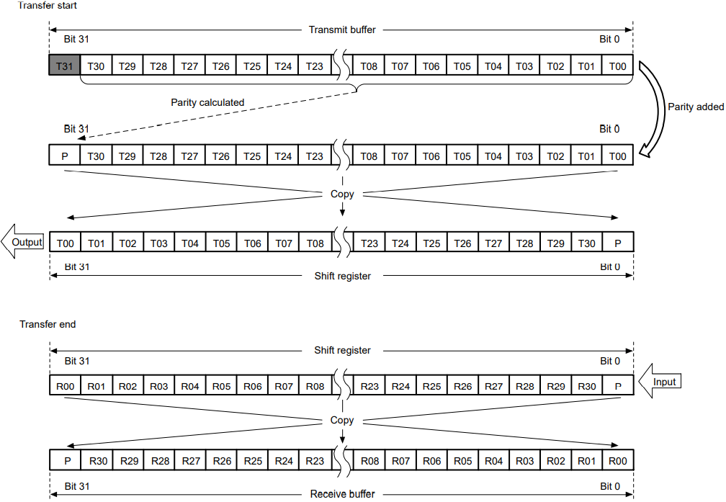
Spi on renesas advance chip (RA family) data formats – Data transmit with parity (2/2)
In mode LSB – first, parity bit will be placed at the start of bit stream (at MSB)
Transmit the parity data format for LSB – first transmission
Note: For the parity disable, please refer to slide Overview how he works – data transmission concept (1/6)

Slide 31
Spi on renesas advance chip (RA family) interrupt sources
SPI has 5 types of interrupt sources:
+ Receive buffer full
+ Transmit buffer empty
+ SPI error (mode-fault, underrun, overrun or parity error)
+ SPI idle
+ Communication - end

Slide 32
Spi on renesas advance chip (RA family) error detection
SPI module provides 4 error detection method when transferring the data:
+ Overrun error (Please refer to: appendix error types of SPI module – Overrun error (1/4))
+ Parity error (Please refer to: appendix error types of SPI module – parity errors)
+ Mode fault error (Please refer to: appendix error types of SPI module – Mode fault (1/2))
+ Underrun error (Please refer to: appendix error types of SPI module – underrun errors)

Slide 33
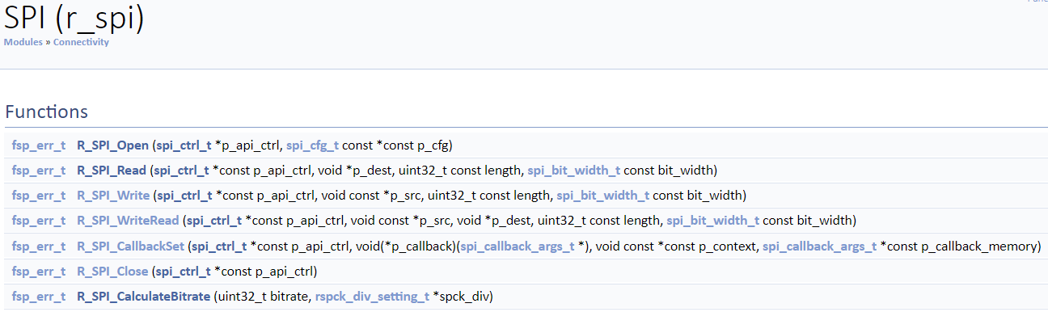
fSP of SPI API
R_SPI_Open(): Init the default value to registers of SPI module
R_SPI_Read(): Receive data from SPI
R_SPI_Write():Transmit data to a SPI device using TX Only Communication Operation Mode
R_SPI_WriteRead():Transmit and receive data simultaneously
R_SPI_CallbackSet(): Updates the user callback and has option of providing memory for callback structure
R_SPI_Close(): Disable module and all associated interrupts
R_SPI_CalculateBitrate(): Calculates the SPBR register value and the BRDV bits for a desired bitrate

Slide 34
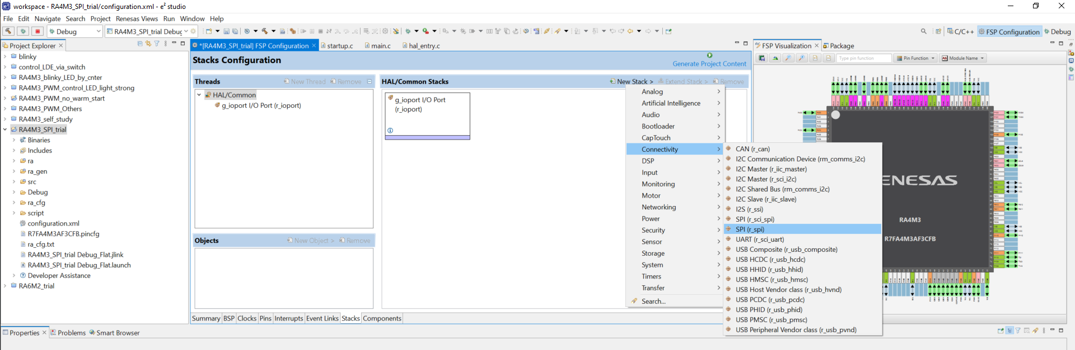
fSP of SPI config with e2studio
Add SPI stack

Slide 35
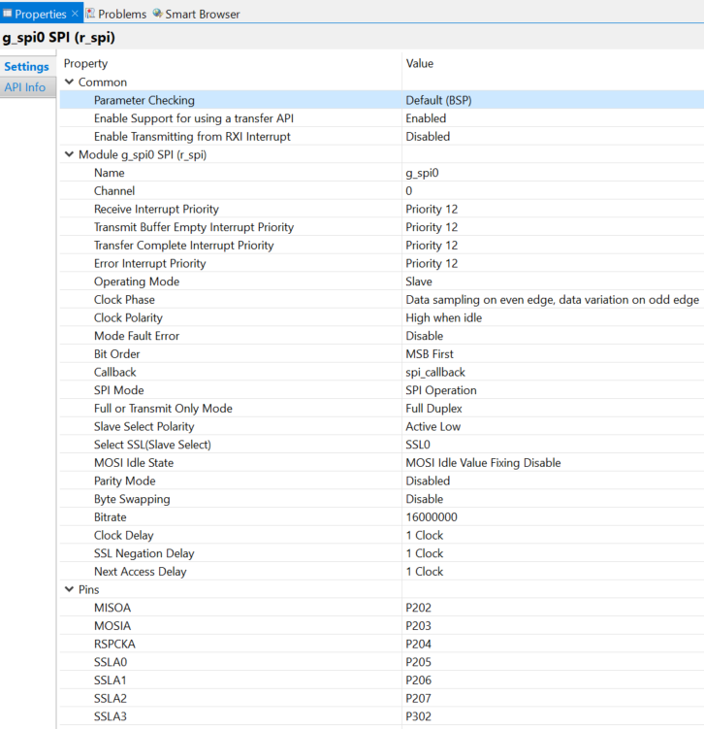
fSP of SPI config with e2studio
Enable parameter checking of APIs
T.B.D
T.B.D
Only channel 0 is available
Interrupt priority
Operation mode of SPI
CPHA
CPOL
Notify mode fault
Bit order transfer mode (MSB-first of LSB-first)

Slide 36
fSP of SPI config with e2studio
Callback function name
SPI operation (4-wire/3-wire)
Serial communication mode
Active level of slave
Perform byte swap before transfer
Adding parity bit
Clock which provide to SPI
Config pin

Slide 37

Q&A

Slide 38
appendix reference material
https://www.analog.com/en/analog-dialogue/articles/introduction-to-spi-interface.html
https://www.netburner.com/spi-what-it-is-how-it-works/
RA4M3 HWUM: https://www.renesas.com/us/en/document/man/ra4m3-group-users-manual-hardware?r=1400806
Serial communication register shift operation: https://deepbluembedded.com/spi-tutorial-with-pic-microcontrollers/
Parity bit: https://en.wikipedia.org/wiki/Parity_bit
SPI concept explanation by video: https://www.youtube.com/watch?v=MCi7dCBhVpQ
SPI FSP API: https://renesas.github.io/fsp/group___s_p_i.html

Slide 39
appendix working flow of SPI register
For the register setting flow, please refer to section “SPI Operation” of HWUM

Slide 40
appendix example
T.B.D

Slide 41
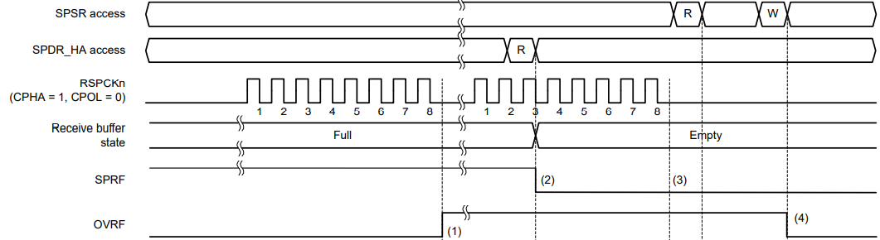
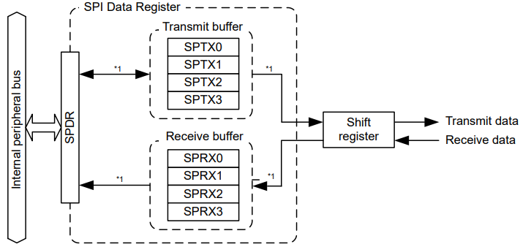
appendix error types of SPI module – Overrun error (1/4)
Overrun occur when receive buffer (SPRX of SPDR/SPDR_HA) is full and terminate transmission with below flag:
+ SPSR.SPRF = 0
+ SPSR.OVRF = 1
Relation between SPRX, SPTX and SPDR

Slide 42
appendix error types of SPI module – Overrun error (2/4)
Normal behavior when receive buffer is full
Detect SPRX full
SPI will stop copy data from shift register to receive buffer (SPRX)
SPSR.OVRF was raised to HIGH to notify about the event

Slide 43
appendix error types of SPI module – Overrun error (3/4)
Normal behavior when receive buffer is full
Receive buffer full interrupt will be raised
SPDR_HA start to read out data in SPRX
When SPDR_HA read all data, SPSR.SPRF change state to notify all data was read and buffer is empty
Data in SPRX also emptied
Note 1: SPDR/SPDR_HA/SPDR_BY act as an intermediate buffer
Note 2: Incase of receive buffer full, transmission will be terminated with below bit
+ SPSR.SPRF = 1
+ SPSR.OVRF = 1

Slide 44
appendix error types of SPI module – Overrun error (4/4)
Abnormal behavior when receive buffer is full (Overrun error)
The SPRX buffer still have not full yet
SPI will not perform copying data from shift register to SPRX
SPI Error interrupt will be raised
Overrun flag detected

Slide 45
appendix error types of SPI module – parity errors
SPI will check the parity bit in the bit stream and judge the transmitted data correct or not. In case the data is incorrect, SPSR.PERF will be raised to 1
In overrun error state, parity check was not performed due to SPI did not copy data from shift register to SPRX
The parity type (even/odd) can be sat by SPCR2.SPOE bit
Note: Please refer Spi on renesas advance chip (RA family) data formats – Pa... to understand the parity type

Slide 46
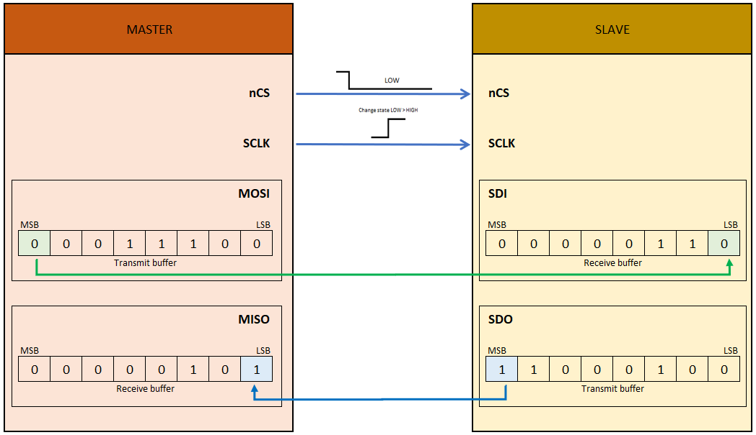

appendix error types of SPI module – Mode fault (1/2)
SPI in Slave mode:
Invalid state changing caused Mode fault error
Transferring 8 bit of data
nCS (SSLni) was disable while data being tramitted
Error conditions:
+ SPCR.MSTR bit is 0 (Slave mode)
+ SPCR.MODFEN bit is 1 (Mode fault error detection is enabled)
+ SPCR.SPMS bit is 0 (SPI operation mode)
+ SSLni (Slave select pin) was negated (disable) while the data is in transmission

Slide 47

appendix error types of SPI module – Mode fault (1/2)
SPI in Multi master mode:
In multi master mode, mode fault help to stop the driving of output signal and SPI function
As the result, the master was able to be release and switch to other master
Note 1:
+ When MCU is Master, SSLn0 is input LOW, mode fault detected
+ When SPI is Master, SSLn0 is active level, mode fault detected
Note 2: Mode fault status can be checked via below bit
+ SPSR. MODF = 1
+ SPSR.UDRF = 0
Note 2: Mode fault detection only available on Slave mode and Multi-Master mode of SPI Operation
Multi-Master mode with MCU is Master
Error conditions:
+ SPCR.MSTR bit is 1 or 0 (Master/Slave mode)
+ SPCR.MODFEN bit is 1 (Mode fault error detection is enabled)
+ SPCR.SPMS bit is 0 (SPI operation mode)
+ SSLni (Slave select pin) was negated (disable) while the data is in transmission

Slide 48
appendix error types of SPI module – underrun errors
When SPI operating in slave mode/Extended Communication Mode, if the transmission start (SPCR.SPE = 1) before output was data copied to SPTX.
=> The underrun error was detected, and corresponding interrupt will be raised
=> SPSR.MODF = 1 and SPSR.UDRF =1

Slide 49
appendix byte swap - Transmission

Slide 50
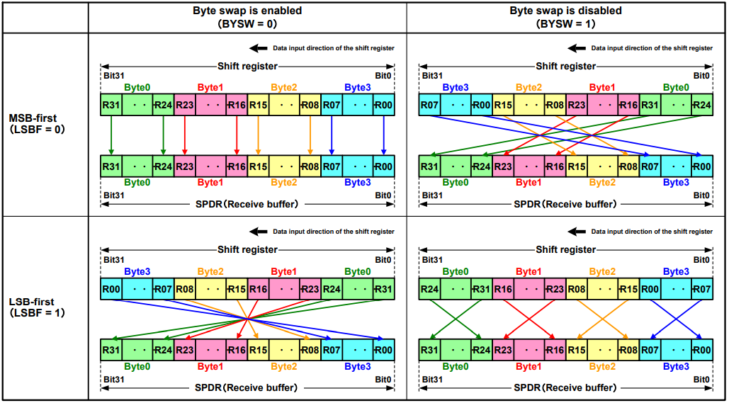
appendix byte swap - Reception

Slide 51
Renesas.com

